Slide 1
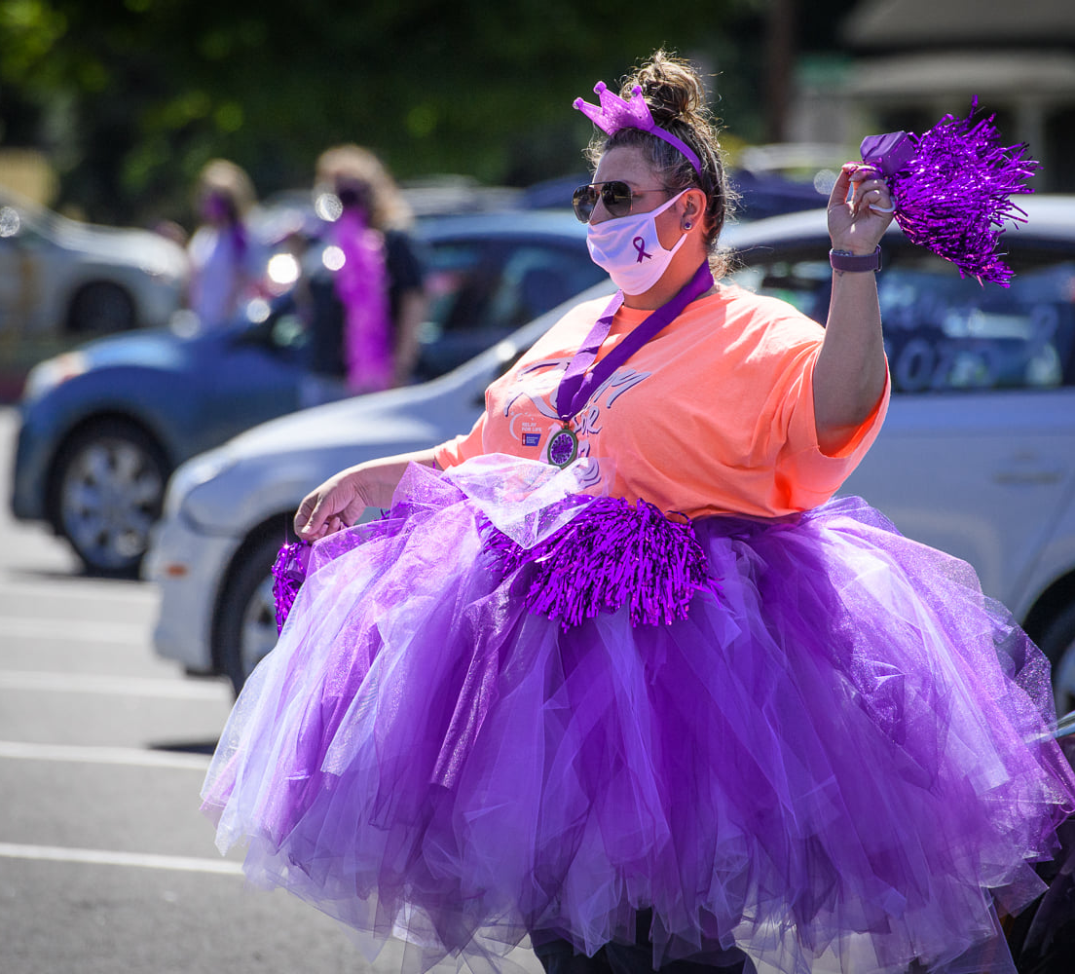
Relay For Life of Moniteau County
2021 Sponsorship Opportunities
RelayForLife.org/MoniteauCOMO

Slide 2
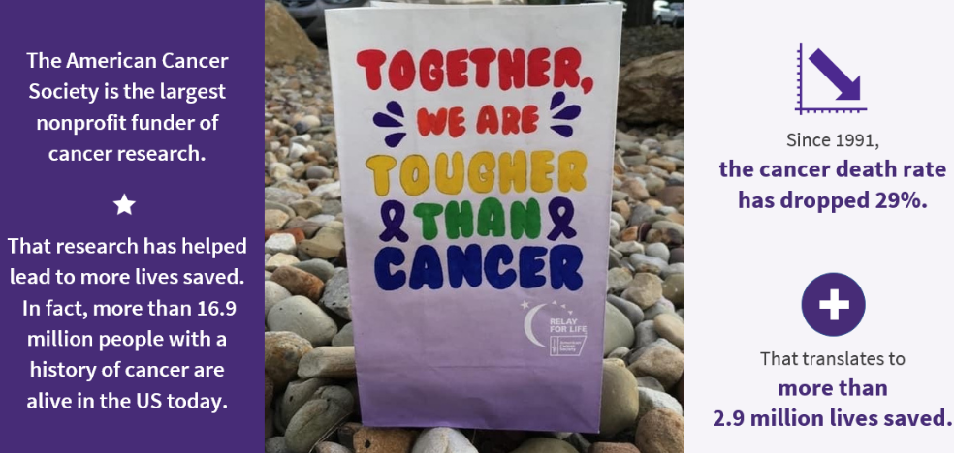
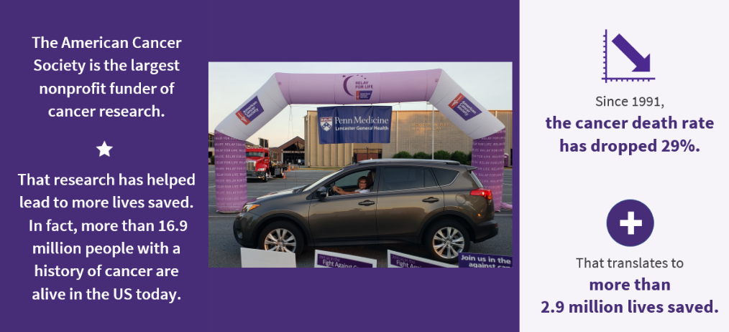
Image pending media release. Expected soon.

Slide 3
SPONSOR BENEFIT | PRESENTING $5,000 | PLATINUM $2,500 | GOLD $1,500 | SILVER $1,000 | BRONZE $500 | COMMUNITY $250
Employee engagement opportunity through custom company kickoff for your Relay For Life team | P
Speaking opportunity during your local Relay For Life event | P
Television and radio interview opportunities | P
Sponsor logo featured on all post-event thank-you emails | P
Co-branded social media frames and cover photos made available to all event participants | P
Opportunity to co-present (along with ACS) a local pre or post event activation (Examples include: a Photo Booth, Selfie Stop, Scavenger Hunt, or a locally designed experience | P | P
Access to American Cancer Society workplace wellness offerings | P | P
Verbal recognition during your Relay For Life event opening ceremony | P | P
Promotional space during your Relay For Life event with an opportunity to provide ACS-approved giveaways | P | P
Company representative invitation to other American Cancer Society VIP functions in your community | P | P
Premier Recognition on your local Relay For Life event Facebook timeline with in-feed post and story | P | P | P
Sponsor logo featured on all event promotional materials | P | P | P
Recognition in ACS event news releases | P | P | P
Rights for you to promote sponsorship in other publication with co-branded ad (ad templates provided by ACS) | P | P | P
Sponsor logo placement on co-branded event signage on banners, track signs, and video where applicable | P | P | P
Rights to promote sponsorship in company materials with branded image | P | P | P | P
Sponsor logo featured on the home page of your local Relay For Life event website with link to your company website | P | P | P | P
Sponsor name/logo on event T-shirt for Hope Club members (or other comparable benefit mutually agreed upon between sponsor and ACS) | LOGO | LOGO | LOGO | NAME | NAME
Year-round opportunities to engage with participants including representation on the Event Leadership Team | SPEAKING OPPORTUNITY | SPEAKING OPPORTUNITY | SPEAKING OPPORTUNITY | P | P | P
The COVID-19 pandemic has impacted how the American Cancer Society safely conducts Relay For Life and other event experiences in your community. In the event that ACS is unable to deliver any of the benefits above due to alterations for public safety, comparable benefit substitutions will be made.

Slide 4
Presenting Sponsor
$5,000
Employee engagement opportunity through custom company kickoff for your Relay For Life team
Speaking opportunity during your local Relay For Life event
Television and radio interview opportunities
Sponsor logo featured on all post-event
thank-you emails
Co-branded social media frames and cover photos made available to all event participants
Opportunity to co-present (along with ACS) a local pre or post event activation (Examples include: a Photo Booth, Selfie Stop, Scavenger Hunt, or a locally designed experience
Access to American Cancer Society workplace wellness offerings
Verbal recognition during your Relay For Life event opening ceremony
Promotional space during your Relay For Life event with an opportunity to provide ACS-approved giveaways
Company representative invitation to other American Cancer Society VIP functions in your community
Premier Recognition on your local Relay For Life event Facebook timeline with in-feed post and story
Sponsor logo featured on all event promotional materials
Recognition in ACS event news releases
Rights for you to promote sponsorship in other publication with co-branded ad (ad templates provided
by ACS)
Sponsor logo placement on co-branded event signage on banners, track signs, and video where applicable
Rights to promote sponsorship in company materials with branded image
Sponsor logo featured on the home page of your local Relay For Life event website with link to your company website
Sponsor logo on event T-shirt for
Hope Club members (or other comparable benefit mutually agreed upon between sponsor and ACS)
Year-round opportunities to engage with participants including representation on the Event Leadership Team
Platinum Sponsor
$2,500
Opportunity to co-present (along with ACS) a local pre or post event activation (Examples include: a Photo Booth, Selfie Stop, Scavenger Hunt, or a locally designed experience
Access to American Cancer Society workplace wellness offerings
Verbal recognition during your Relay For Life event opening ceremony
Promotional space during your Relay For Life event with an opportunity to provide ACS-approved giveaways
Company representative invitation to other American Cancer Society VIP functions in your community
Premier Recognition on your local Relay For Life event Facebook timeline with in-feed post and story
Sponsor logo featured on all event promotional materials
Recognition in ACS event news releases
Rights for you to promote sponsorship in other publication with co-branded ad (ad templates provided
by ACS)
Sponsor logo placement on co-branded event signage on banners, track signs, and video where applicable
Rights to promote sponsorship in company materials with branded image
Sponsor logo featured on the home page of your local Relay For Life event website with link to your company website
Sponsor logo on event T-shirt for
Hope Club members (or other comparable benefit mutually agreed upon between sponsor and ACS)
Year-round opportunities to engage with participants including representation on the Event Leadership Team

Slide 5
Gold Sponsor
$1,500
Premier Recognition on your local Relay For Life event Facebook timeline with in-feed post and story
Sponsor logo featured on all event promotional materials
Recognition in ACS event news releases
Rights for you to promote sponsorship in other publication with co-branded ad (ad templates provided
by ACS)
Sponsor logo placement on co-branded event signage on banners, track signs, and video where applicable
Rights to promote sponsorship in company materials with branded image
Sponsor logo featured on the home page of your local Relay For Life event website with link to your company website
Sponsor logo on event T-shirt for
Hope Club members (or other comparable benefit mutually agreed upon between sponsor and ACS)
Year-round opportunities to engage with participants including representation on the Event Leadership Team
Silver Sponsor
$1,000
Rights to promote sponsorship in company materials with branded image
Sponsor logo featured on the home page of your local Relay For Life event website with link to your company website
Sponsor logo on event T-shirt for
Hope Club members (or other comparable benefit mutually agreed upon between sponsor and ACS)
Year-round opportunities to engage with participants including representation on the Event Leadership Team
Bronze Sponsor
$500
Sponsor logo on event T-shirt for
Hope Club members (or other comparable benefit mutually agreed upon between sponsor and ACS)
Year-round opportunities to engage with participants including representation on the Event Leadership Team
Community Sponsor
$250
Year-round opportunities to engage with participants including representation on the Event Leadership Team

Slide 6

Relay For Life of Moniteau County
2021 Sponsorship Commitment Form
Business name:
Street address:
City: State: ZIP:
Contact name:
Telephone number (business): Fax number:
Email: Web address:
COMMITMENT LEVEL
☐ $5,000 – Presenting ☐ $1,500 – Gold ☐ $500 – Bronze
☐ $2,500 – Platinum ☐ $1,000 – Silver ☐ $250 – Community
METHOD OF PAYMENT
☐ Enclosed is my sponsorship check in the amount of $
☐ Charge my credit card (please print clearly).
Card Type: ☐ VISA ☐ MasterCard ☐ Discover ☐ AMEX
Cardholder’s name:
Billing address:
Card number: Exp. date: Security code:
☐ Pay directly to event online at RelayForLife.org/MoniteauCOMO
☐ Please send invoice to:
We are unable to be a designated Relay For Life sponsor this year, but enclosed is our donation of $
Sponsor signature: Date:
(Please sign and retain a copy for your records.)
Please email an EPS logo and JPG logo to Ann.Schroeppel@cancer.org to ensure high-quality printing. If an .eps file is not available,
please send highest quality available. Note, submitting a low resolution logo may require signage to be printed in text in order to maintain quality.
Please note: The COVID-19 pandemic has impacted how the American Cancer Society safely conducts Relay For Life and other event experiences in your community. In the event that ACS is unable to deliver any of the benefits above due to alterations for public safety, comparable benefit substitutions will be made.
Please return form to the address below:
American Cancer Society
1001 Craig Road, Suite 350
Saint Louis, MO 63146
Attention: Relay For Life of Moniteau County (8KK4CM)
Name of team or individual to be credited with this Sponsorship:
☐ Not Applicable

Slide 7
Sponsorship Boost
BOOST YOUR SPONSORSHIP WITH ONE OR MORE OF THE FOLLOWING OPTIONS
Create a company team for your local event. Your team will need a designated captain and you can register at RelayForLife.org/MoniteauCOMO
“Like” your local Relay For Life event with your company social media accounts on Facebook at https://www.facebook.com/Relay-For-Life-of-Moniteau-County-136561519740971
Post your support of your local Relay For Life on your company website and through your social media accounts.
Donate a paid advertisement for your local Relay For Life in local print, radio, or television
media outlet.

